Slide 1


Slide 2
Bulletin Board Geospatial & Open Streetmaps in Odoo
Nikolaus Weingartmair
(Freelance) Developer
Product Manager

Slide 3
Agenda
Introduction
Bulletin Board
Geoengine
OSM Integration

Slide 4
About myself
Nikolaus Weingartmair
ERP for more than 10 years (5 as a developer)
Developing in Odoo since v14, collaborating with OCA since then
Freelancing Focus: Accounting localization topics mainly for Austria/DACH. RZL Interfaces (Account Software) and Fulfillment Integrations.
Start Up Schwarzes Brett -> Regional Event Search for Austria @weinni2000 (Linkedin, Github, X, Gmail)

Slide 5
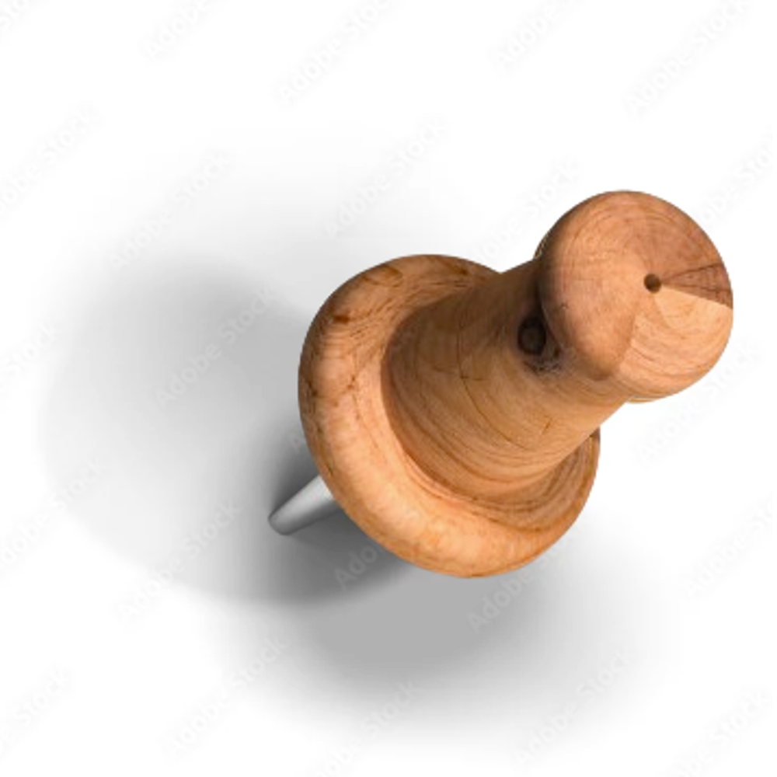
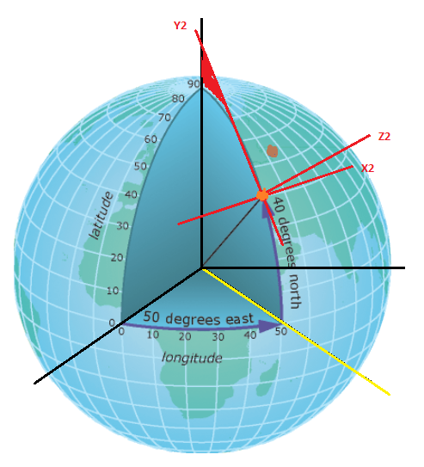


Flyers

Slide 6
Industry has 3 problems
Search, Search, Search
Interface: Easy Search for dummest imagenable End User
SEO: How to get found (google)
Datasources
Ticket vendors
Tourism entities
Public Sources

Slide 7
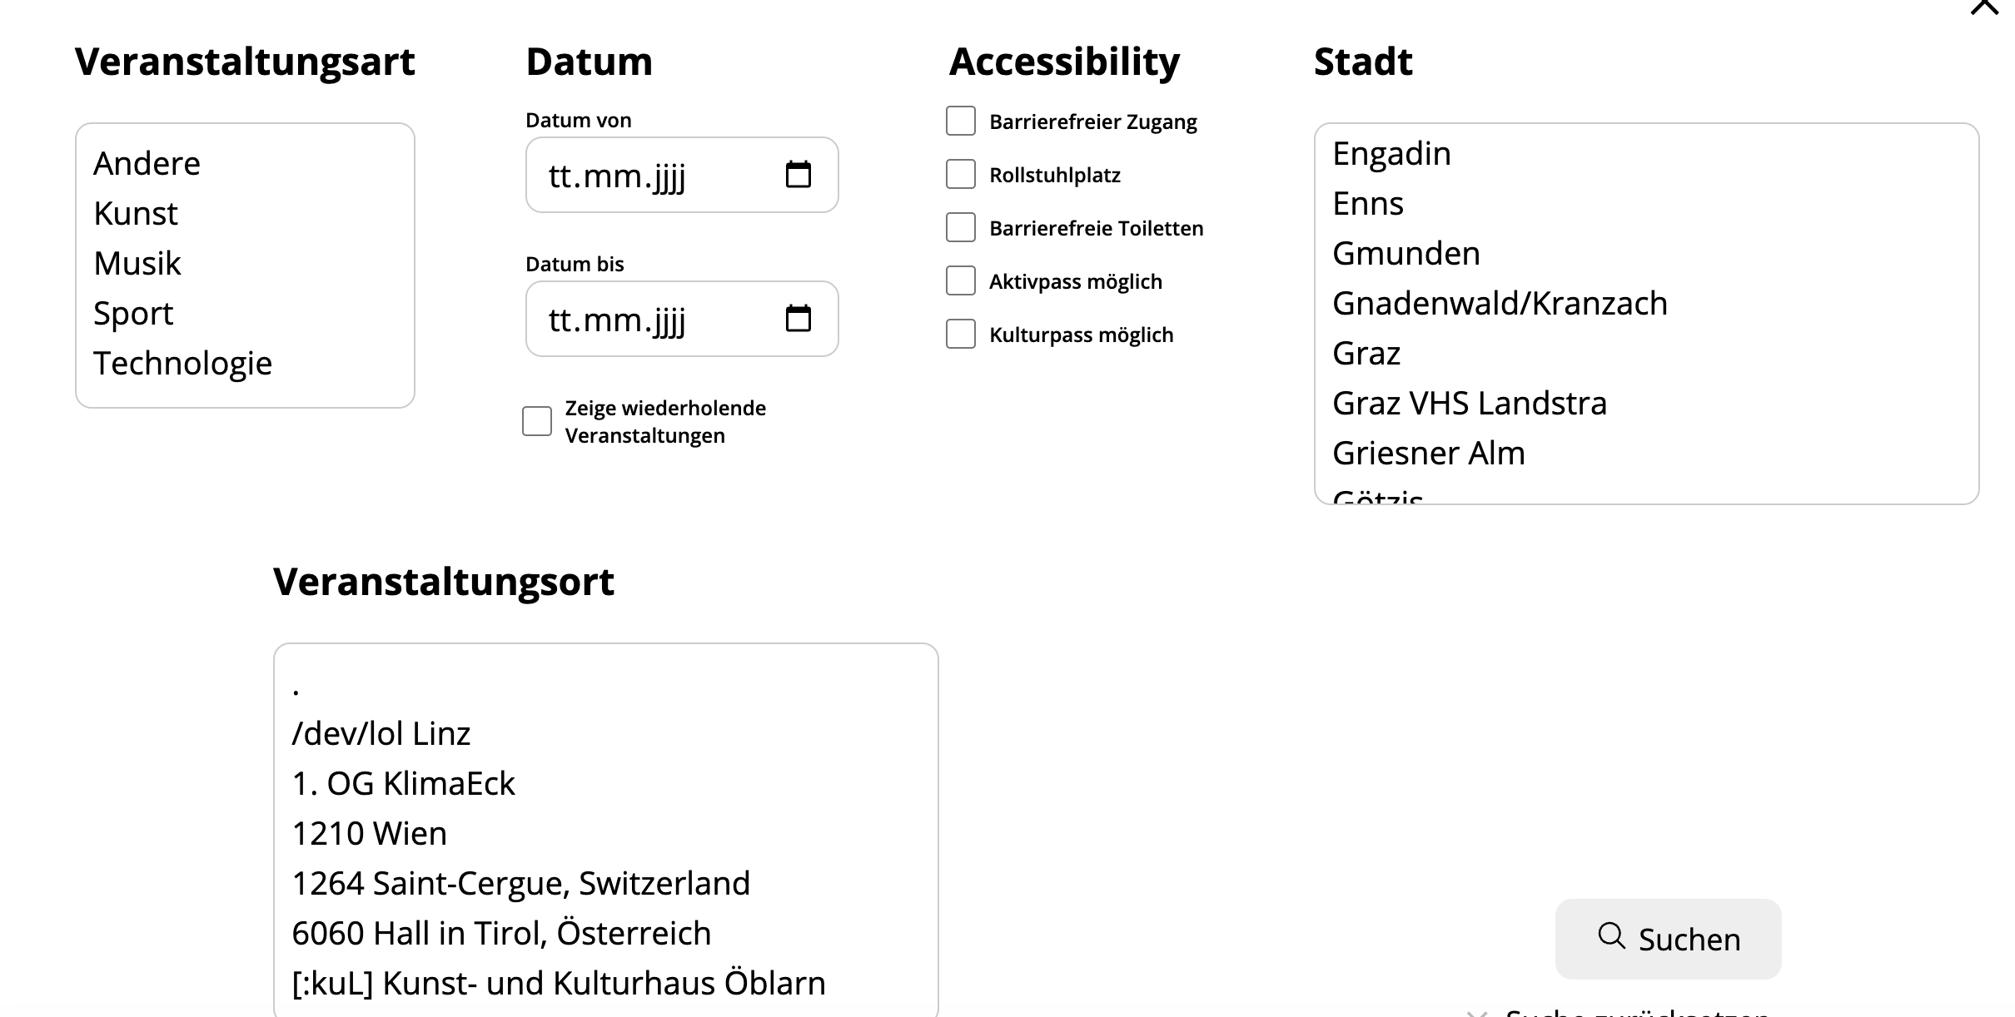

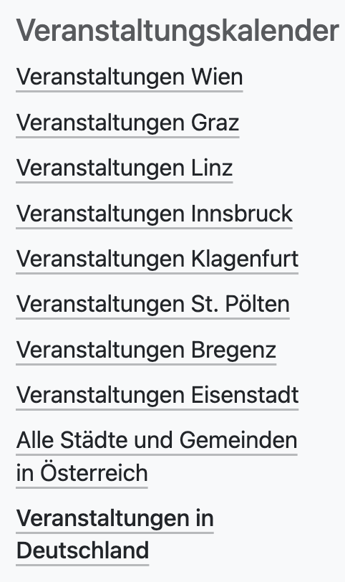
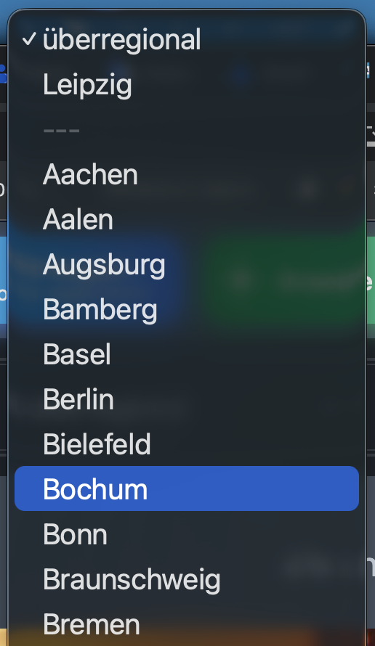
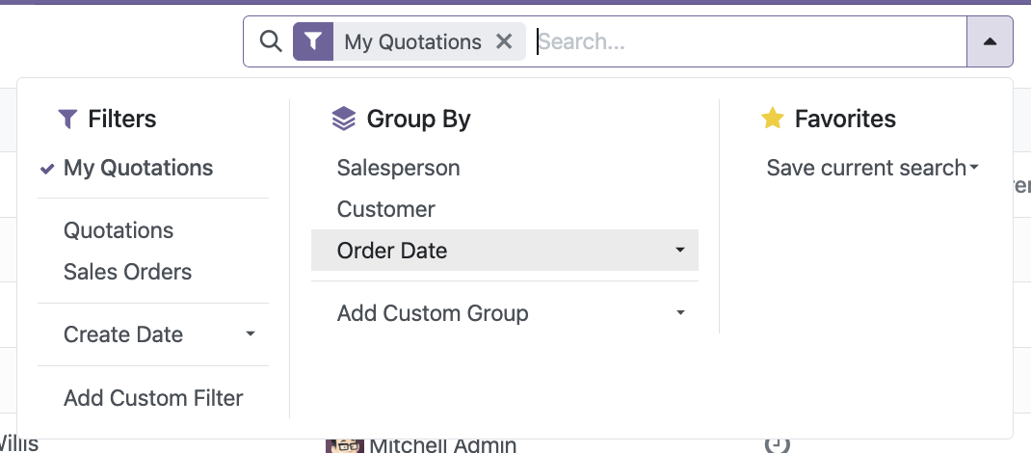


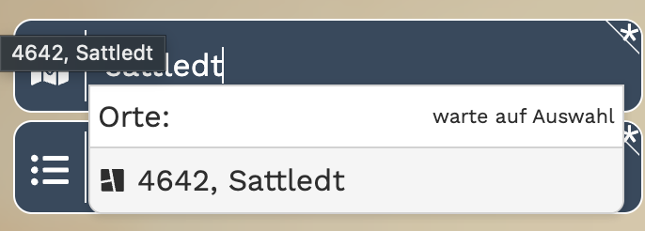


How not to do it

Slide 8
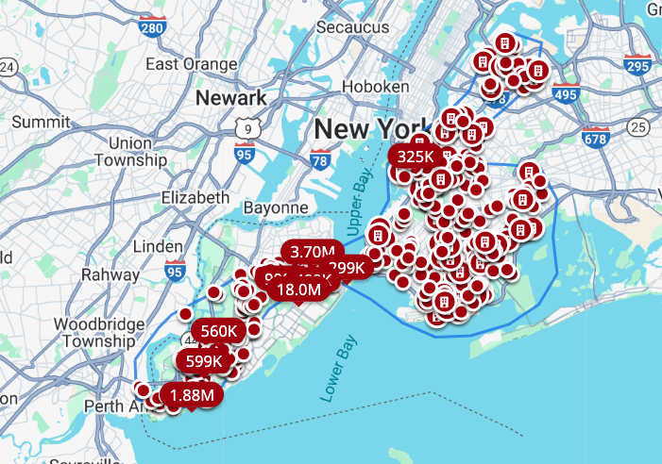



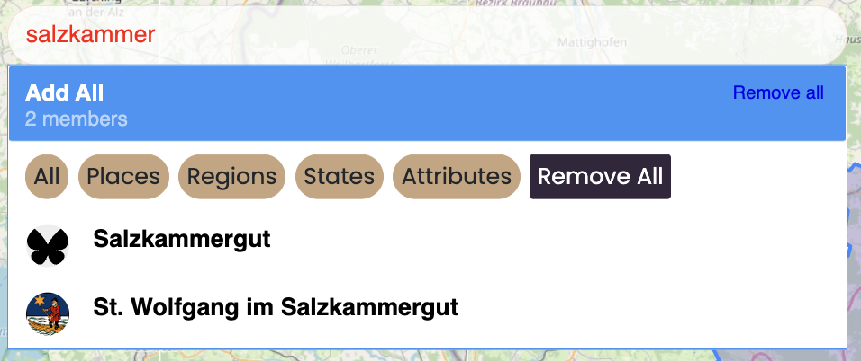
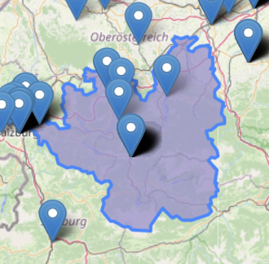
How the big boys are doing it
Notes:
https://www.zillow.com/manhattan-new-york-ny/?searchQueryState=%7B%22isMapVisible%22%3Atrue%2C%22mapBounds%22%3A%7B%22north%22%3A40.743359026593595%2C%22south%22%3A40.711552333533184%2C%22east%22%3A-73.98365115812854%2C%22west%22%3A-74.04287433317737%7D%2C%22filterState%22%3A%7B%22sort%22%3A%7B%22value%22%3A%22globalrelevanceex%22%7D%2C%22price%22%3A%7B%22min%22%3A17000000%2C%22max%22%3Anull%7D%2C%22mp%22%3A%7B%22min%22%3A82644%2C%22max%22%3Anull%7D%2C%22sch%22%3A%7B%22value%22%3Atrue%7D%7D%2C%22isListVisible%22%3Atrue%2C%22mapZoom%22%3A14%2C%22usersSearchTerm%22%3A%22Manhattan%2C%20New%20York%2C%20NY%22%2C%22regionSelection%22%3A%5B%7B%22regionId%22%3A12530%2C%22regionType%22%3A17%7D%5D%7D

Slide 9
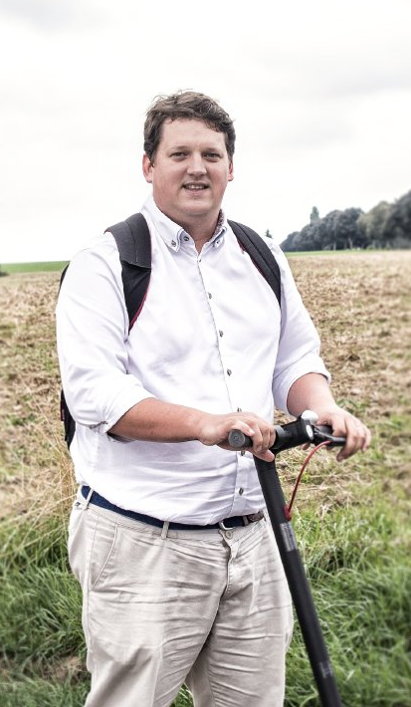
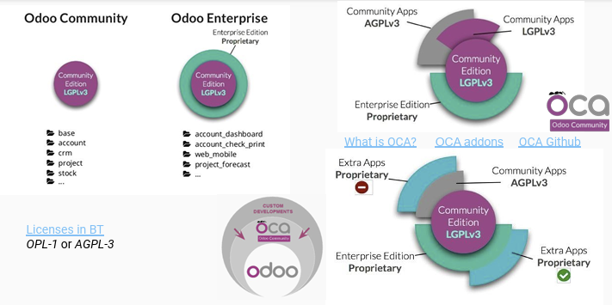
Odoo

Slide 10
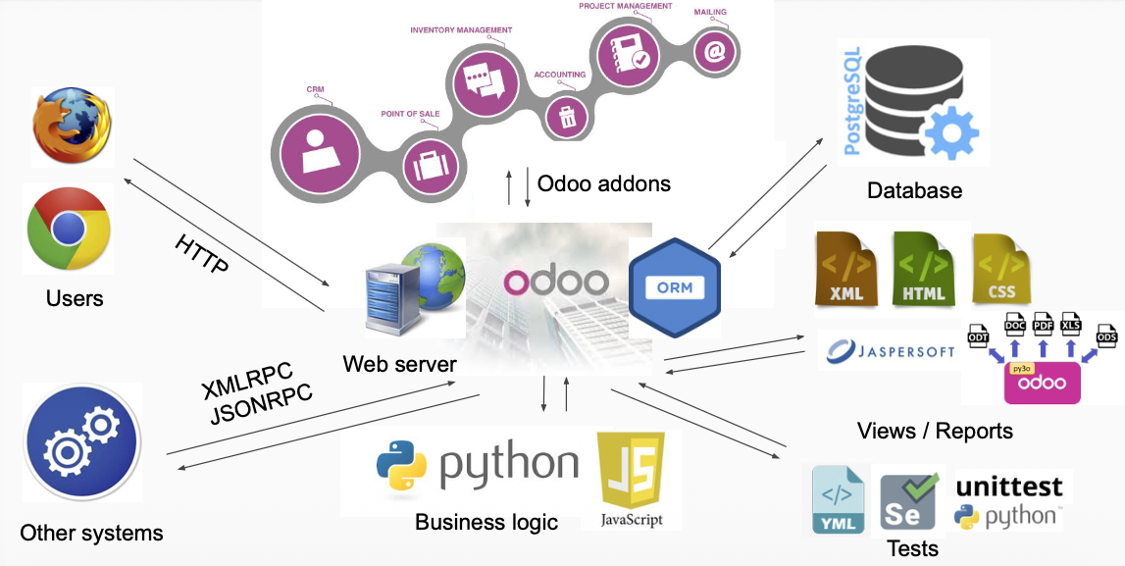
Architecture

Slide 11
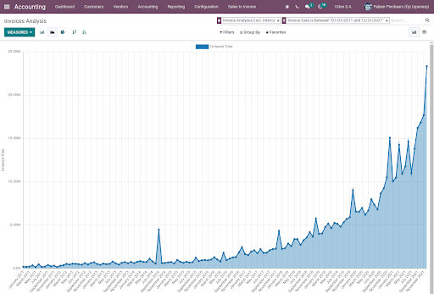

Odoo
130 000 customers
New customers 10.000 a month
2024: 4300 employees
2025: 6500

Slide 12

OCA Odoo community association
Big companies contribute
Devtools
Modules with high upkeep (Migration every year)
High code quality
Several Meetups (OCA Days Spain, OCA Days Brussels)

Slide 13

Geospatial
Develped by Camp2Camp
Made originaly as a backend for the swiss tourism agency.

Slide 14
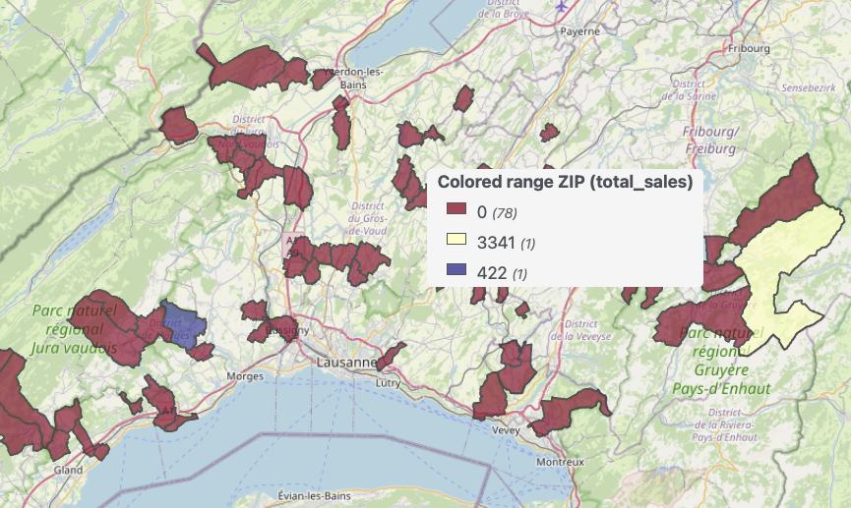


Geoengine (Repo: Geospatial)
View Type
Color depending on other fields
Filter points from areas
Notes:
https://runboat.odoo-community.org/webui/builds.html?repo=oca/rma&target_branch=17.0 http://localhost:8069/odoo/action-94?view_type=geoengine

Slide 15
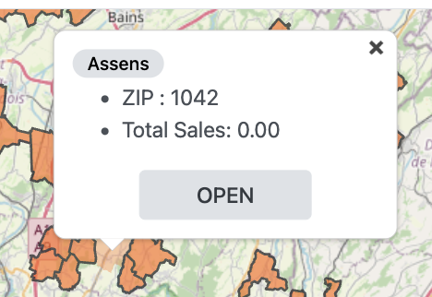
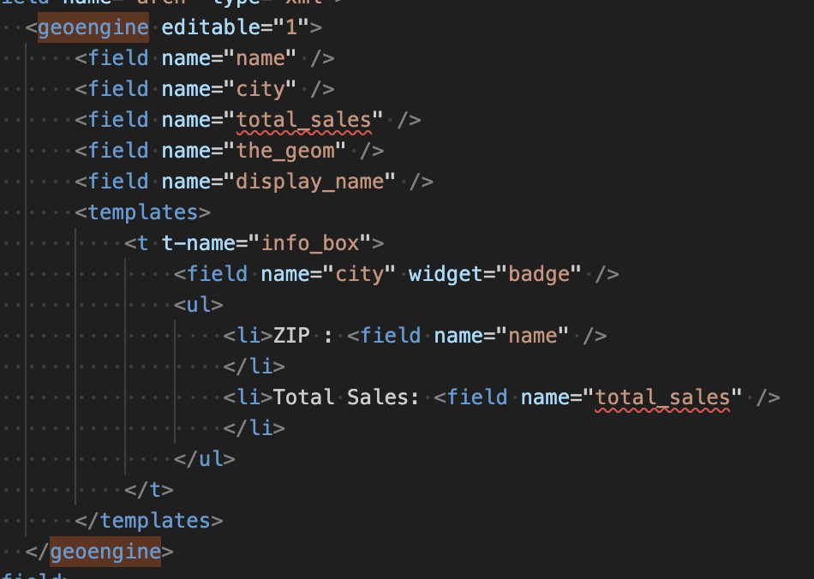
Demo

Slide 16
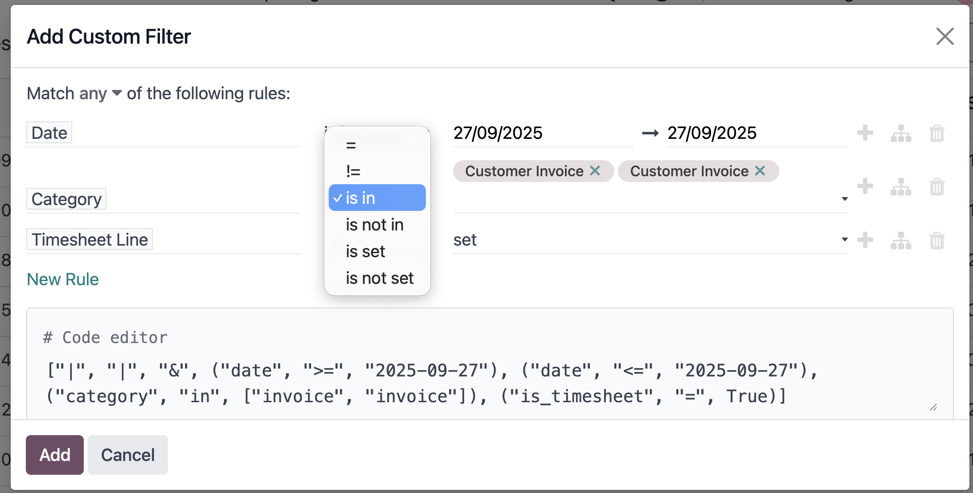
Odoo Domain Filter
Hungarian Notation:
[‚&‘, (date','=‚,‘2025-09-27‘),(‚category‘,‘in‘,[„Rock“, “Pop“])]
Gets complicated fast
Domain.and([domainList, ganttDomain])

Slide 17
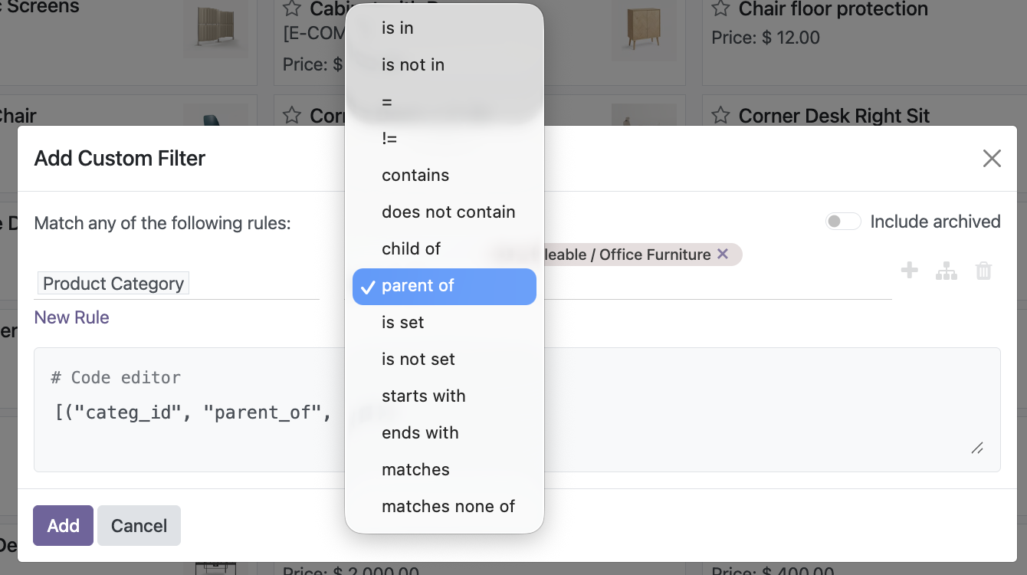
Complex Serach for Categories
Metal
Soft Metal
Death Metal

Slide 18
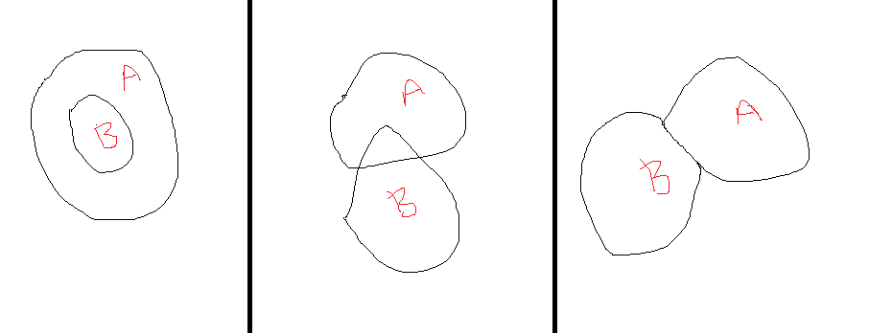
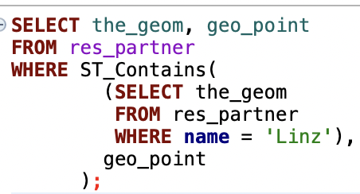
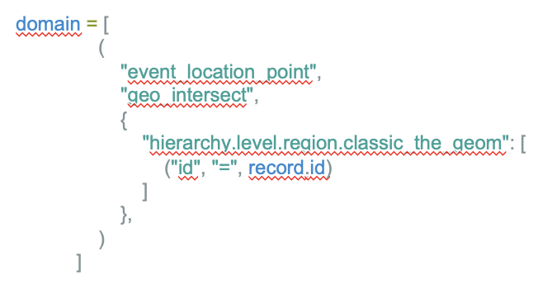
Geospatial queries
SQL
Odoo Filter

Slide 19





Slide 20
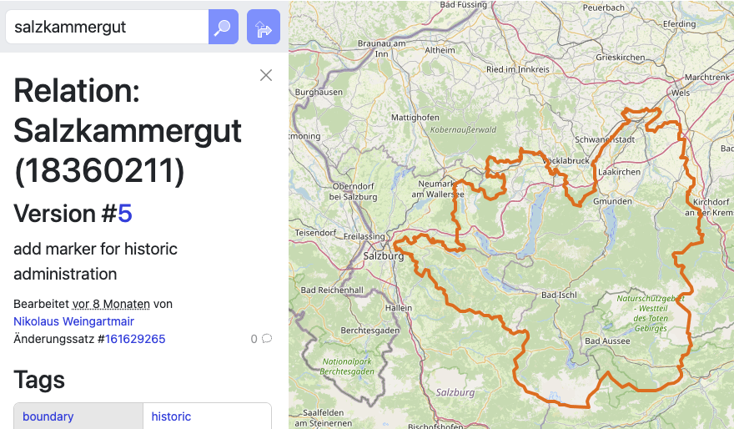

OSM
Who has never used it?
Who has used it for projects? Who has ever contributed?
Notes:
https://www.openstreetmap.org/relation/18360211#map=9/47.722/14.230

Slide 21



Building Blocks
Nodes
Point in space (lat lng)
Eg. Tree, trash bin, etc
Ways
Linear features
Eg. Road, river, boraders
Relations
For complex things such as routes

Slide 22
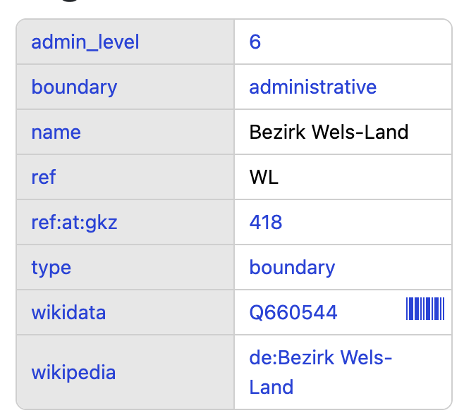
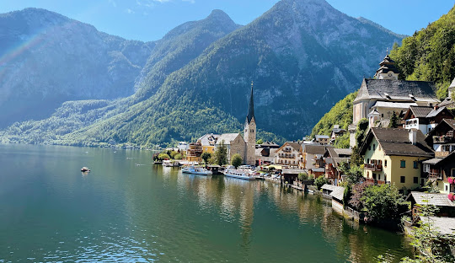
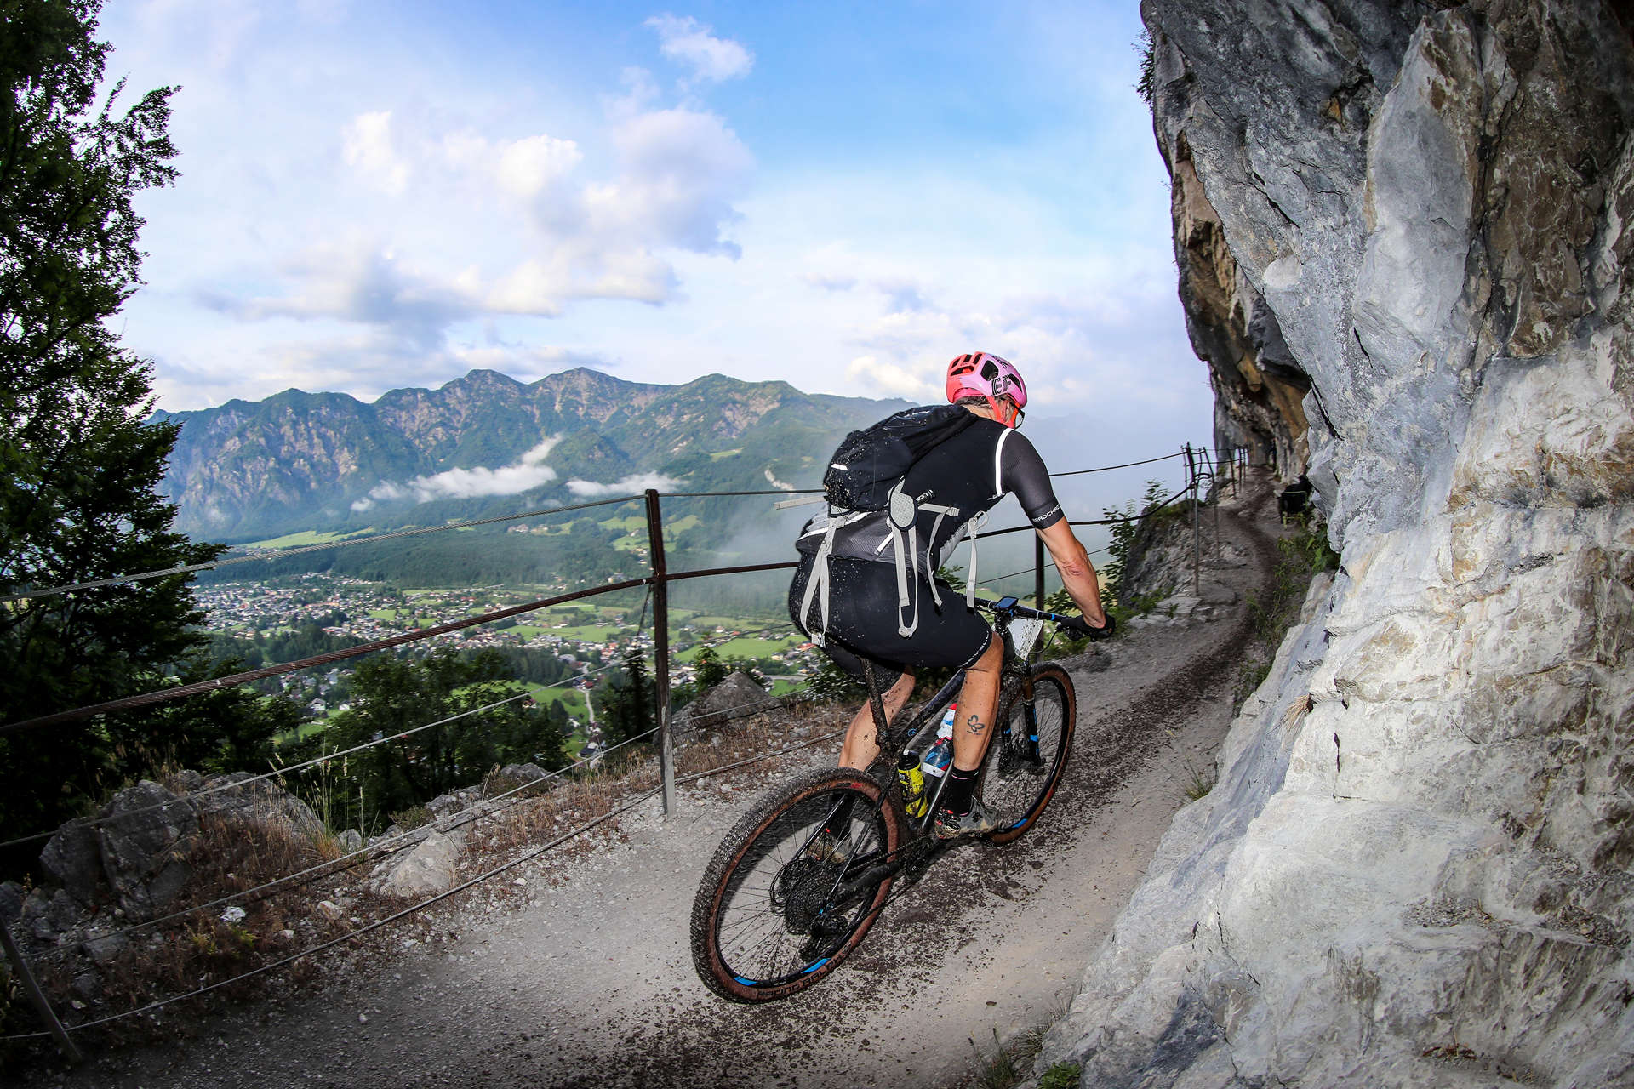
Tags Salzkammergut
Beautiful lakes
Small villages
Mountain Bike races
Chinese completely rebuild it in China
Notes:
https://www.openstreetmap.org/relation/18360211

Slide 23

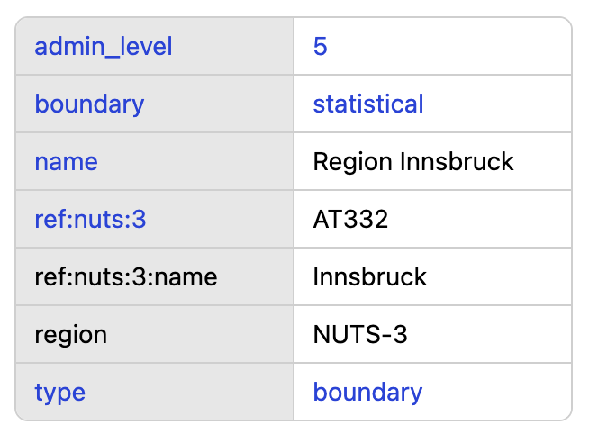
Advanced
JOSM (Java Open Street Maps Editor)
OSM Mailinglist
Relationships
Notes:
https://community.openstreetmap.org/

Slide 24
Erstellen eines Eintrags

Slide 25
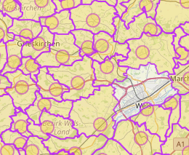
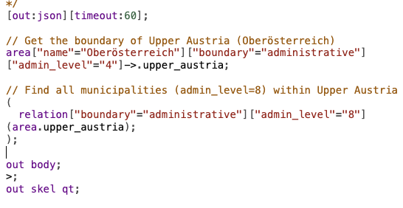
Overpass (OSM API)
Notes:
https://overpass-turbo.eu/ [out:json][timeout:60];
// Get the boundary of Upper Austria (Oberösterreich)
area["name"="Oberösterreich"]["boundary"="administrative"]["admin_level"="4"]->.upper_austria;
// Find all municipalities (admin_level=8) within Upper Austria
(
relation["boundary"="administrative"]["admin_level"="8"](area.upper_austria);
);
out body;
>;
out skel qt;

Slide 26
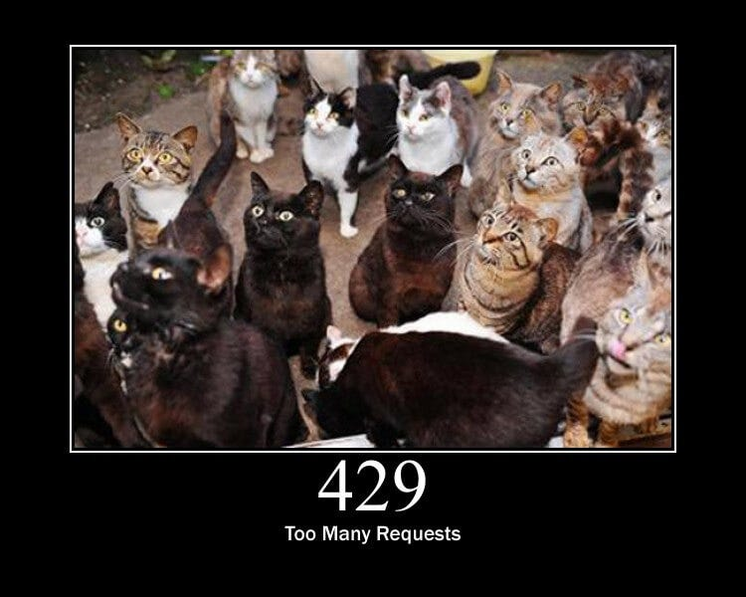
How to not do it
Load it from the official API
Docker Based instance of OSM loaded with
n7m
Local low latancy
Rate limit free
Finally something i can use with async

Slide 27
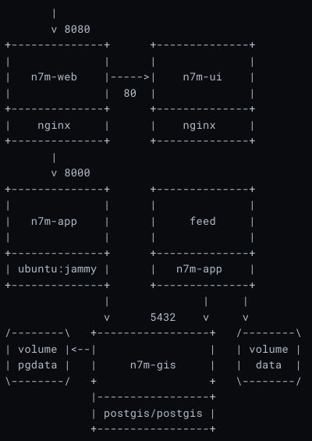
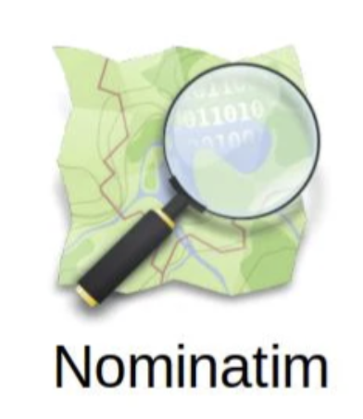
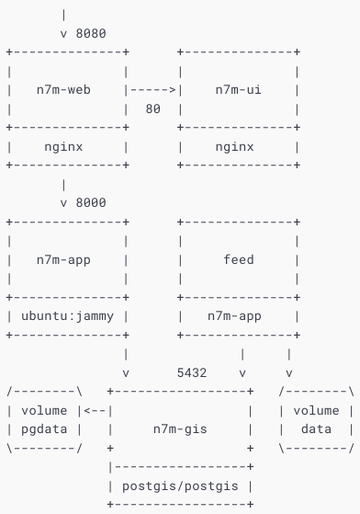
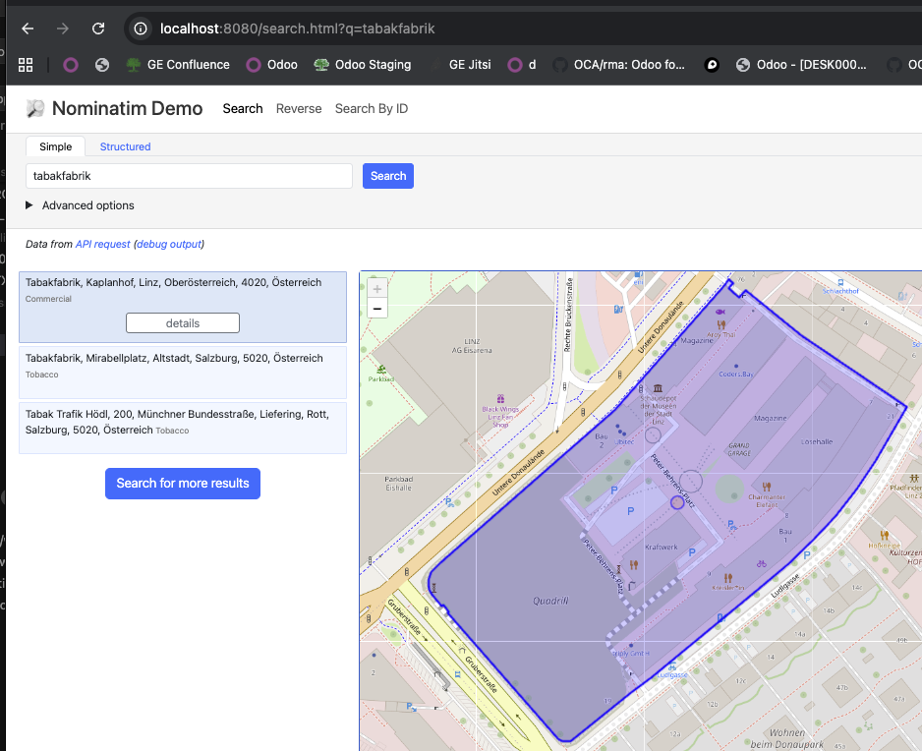
N7M

Slide 28

No network latency
async makes sense ;)

Slide 29

Can we do better?
Hint OSM is also using Postgres
Dumps are available for each country.

Slide 30
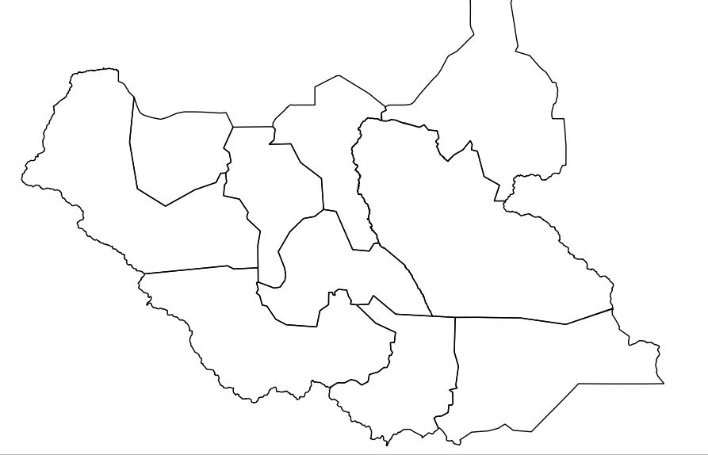
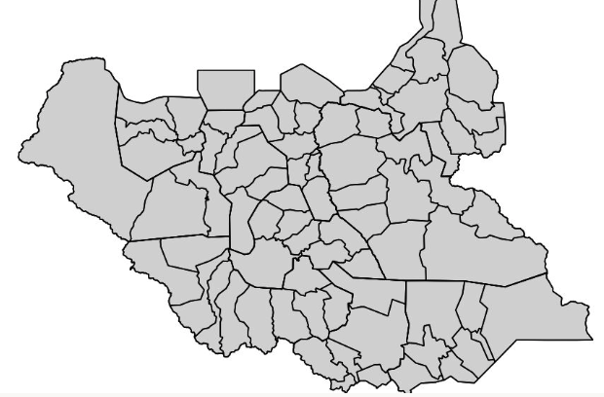
Qotcha
Shapes müssen reduziert werden
When the shapes get reduced individually it looks terrible
Special heuristics to reduce size but keep common boarders aligned

Slide 31
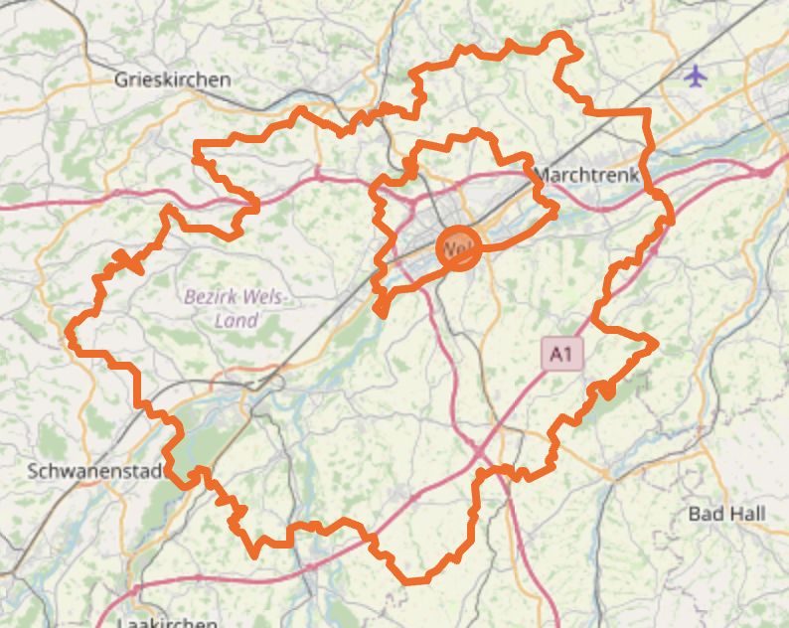
Gotcha
Polygons & Multipolygons
Always take Multipolygons

Slide 32
Outlook
AI -> Promt to query

Slide 33

Questions
Nikolaus Weingartmair (linkedin)
weinni2000 (gmail, github)

Slide 34



Thank you to our Event Sponsors

